Slide 1


MARKET BASKET ANALYSIS
AVNITA MANU PATEL
PERSEVEX EDUCATION CONSULTANCY LLP

Slide 2
INTRODUCTION
Market Basket Analysis is a data mining technique used to identify relationships between products that are frequently purchased together.
It helps businesses understand customer buying behavior and improve sales through product recommendations and cross-selling strategies.
In this project, association rules are generated using the Apriori algorithm, and the results are visualized through an interactive dashboard in Microsoft Power BI for better insights and decision-making.

Slide 3
USES
Helps in product recommendation (suggest related items to customers)
Supports cross-selling and up-selling strategies
Improves store layout optimization
Enables targeted marketing and personalized offers
Assists in inventory management
Supports data-driven decision-making using Microsoft Power BI

Slide 4
IMPORTANCE
Helps understand customer buying behavior
Identifies hidden patterns and product relationships
Improves sales through cross-selling and recommendations
Enhances customer experience with relevant suggestions
Supports better business decisions using data insights
Enables effective visualization and analysis using Microsoft Power BI

Slide 5
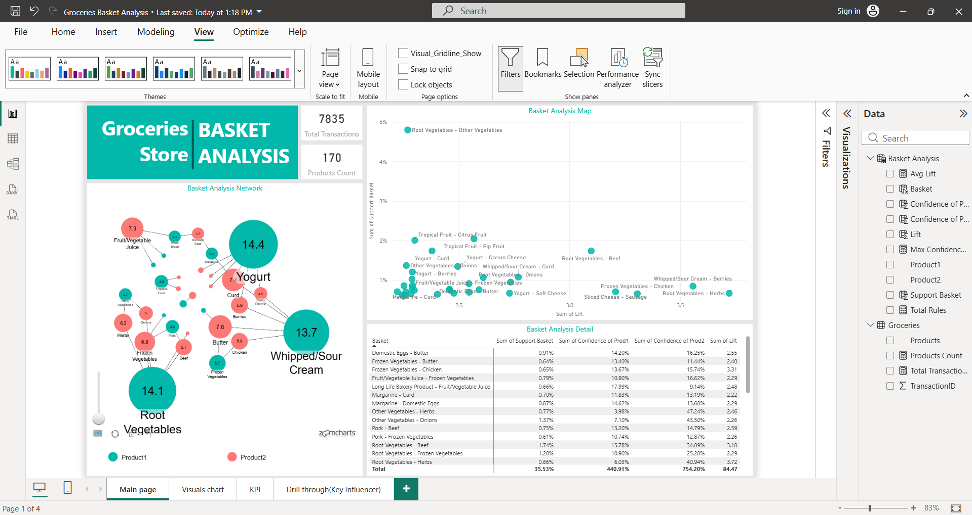

Slide 6
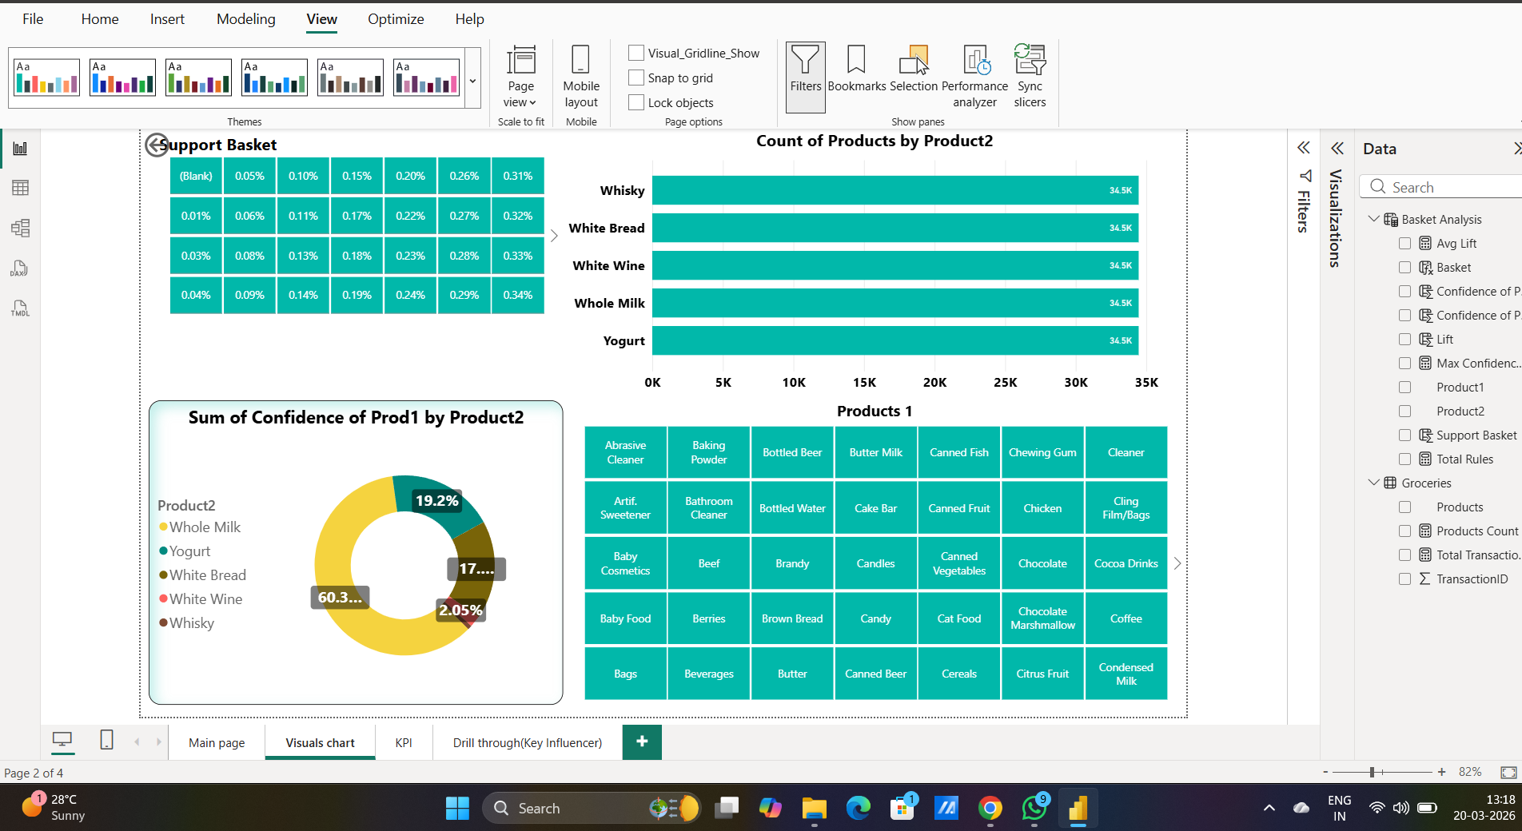

Slide 7
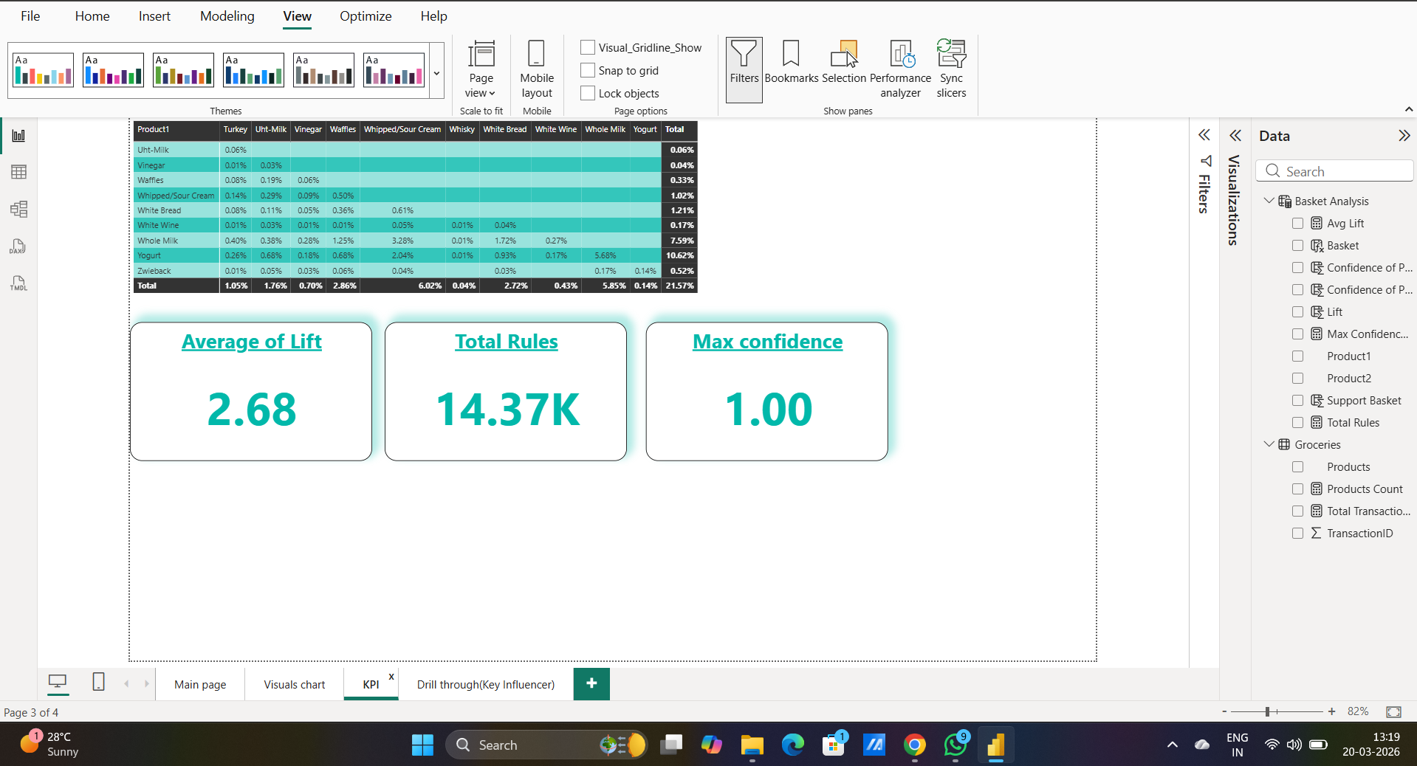

Slide 8
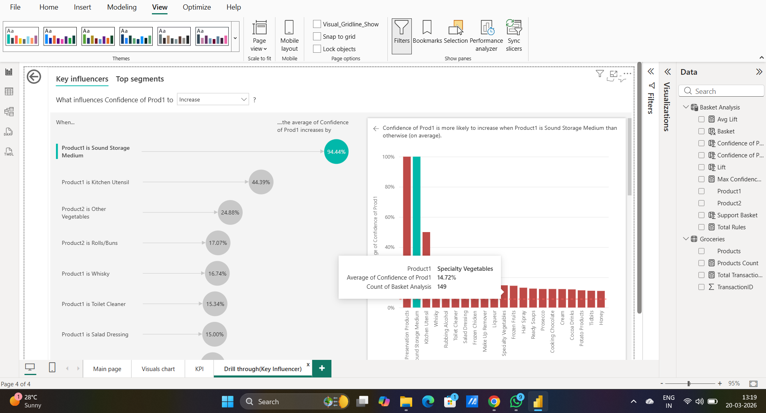

Slide 9
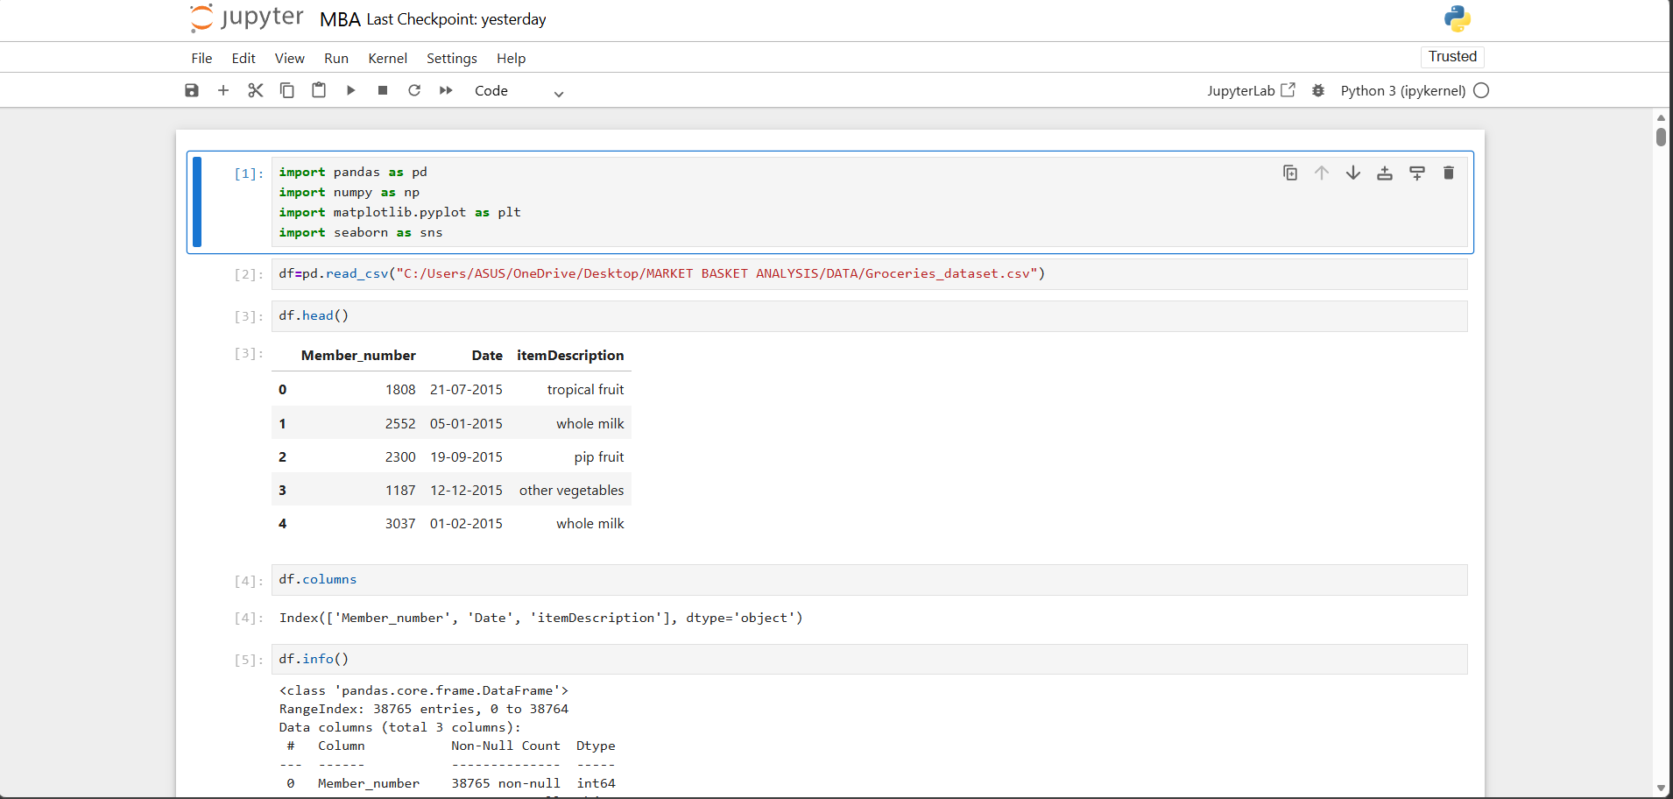

Slide 10
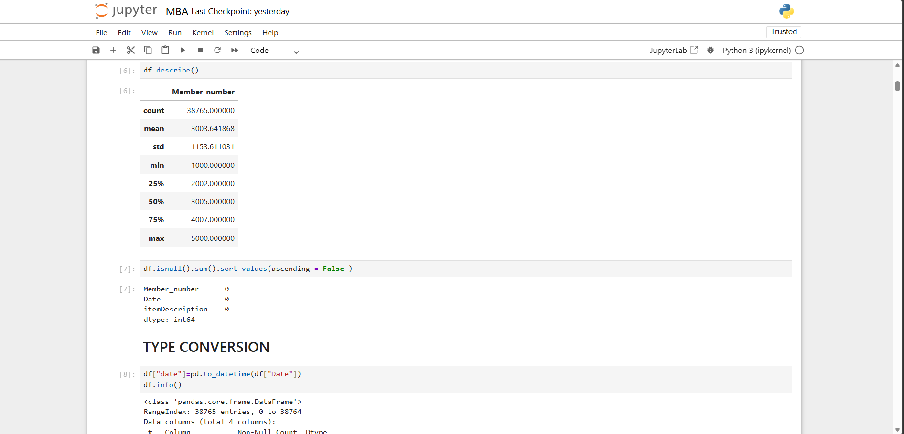

Slide 11
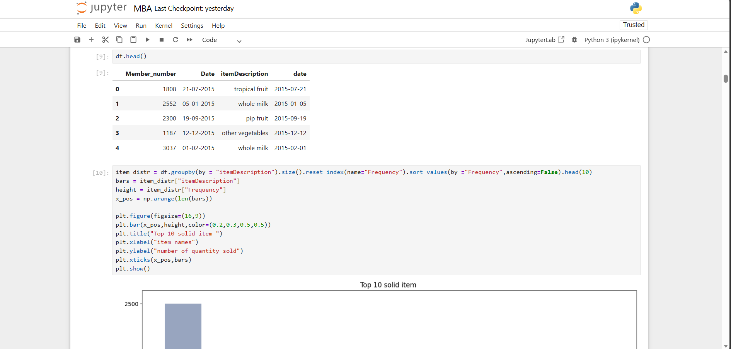

Slide 12
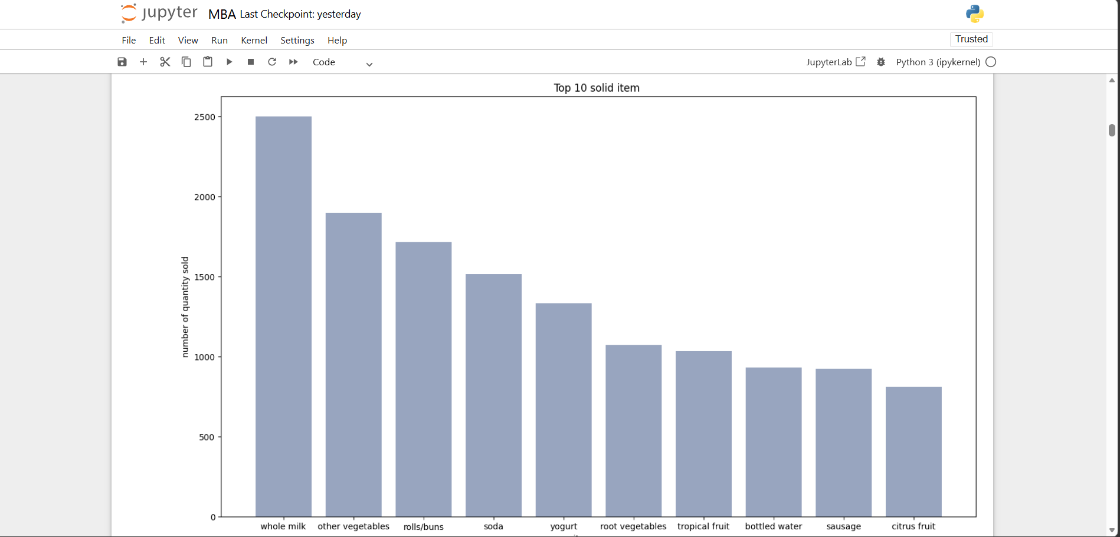

Slide 13
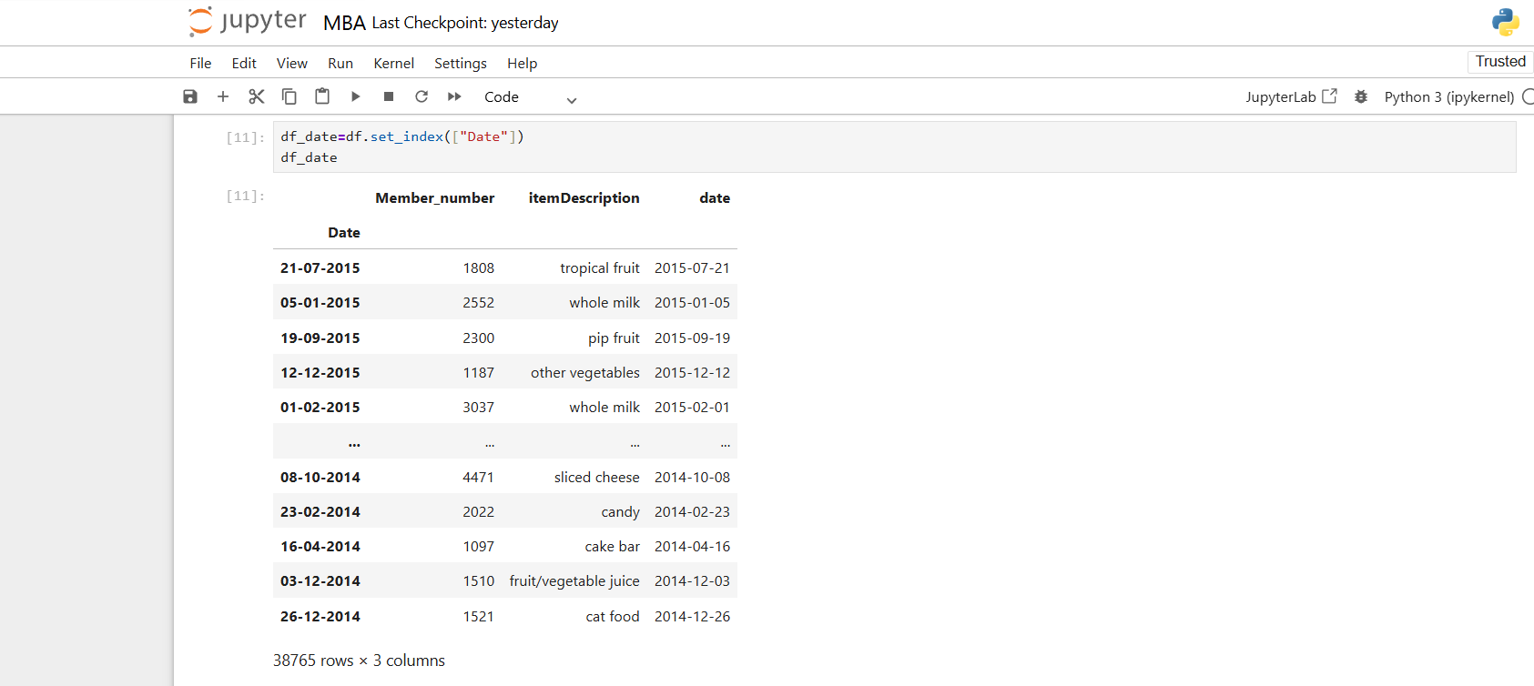

Slide 14
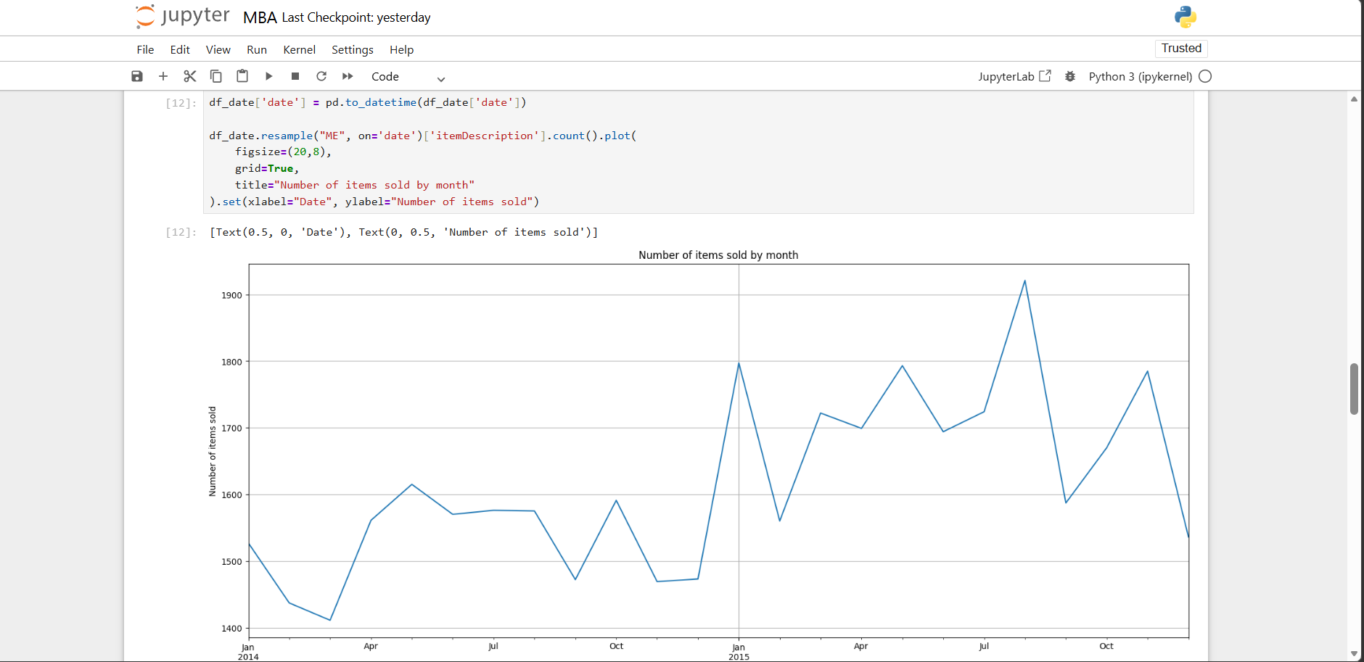

Slide 15
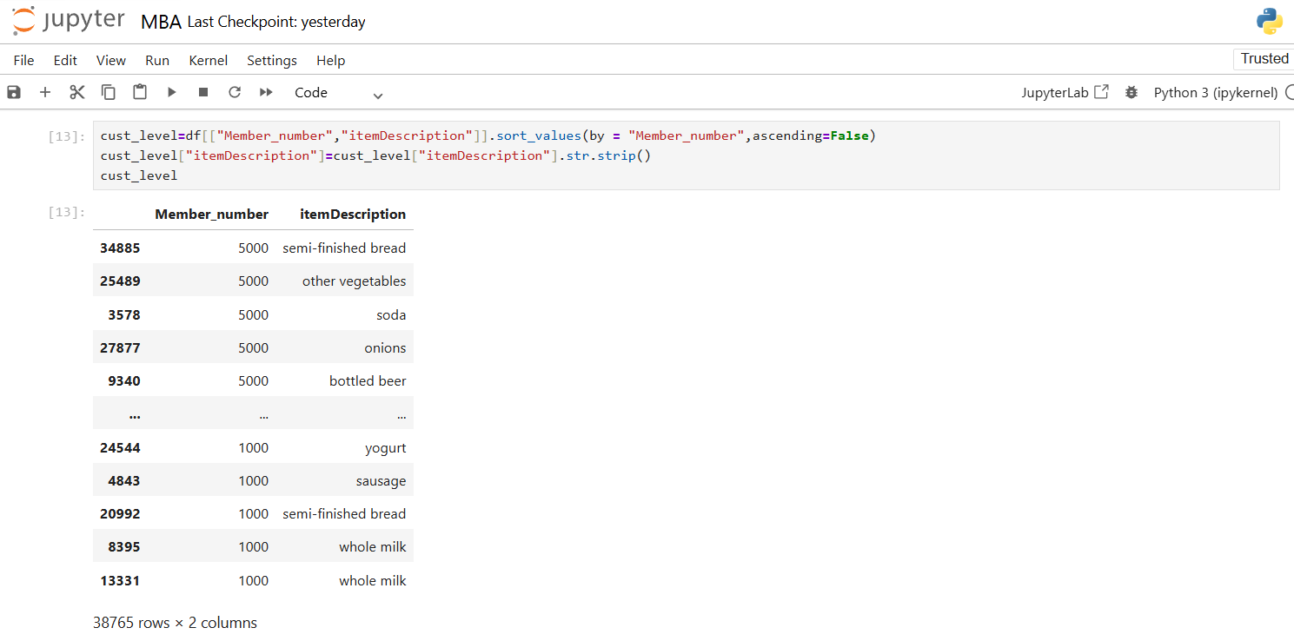

Slide 16
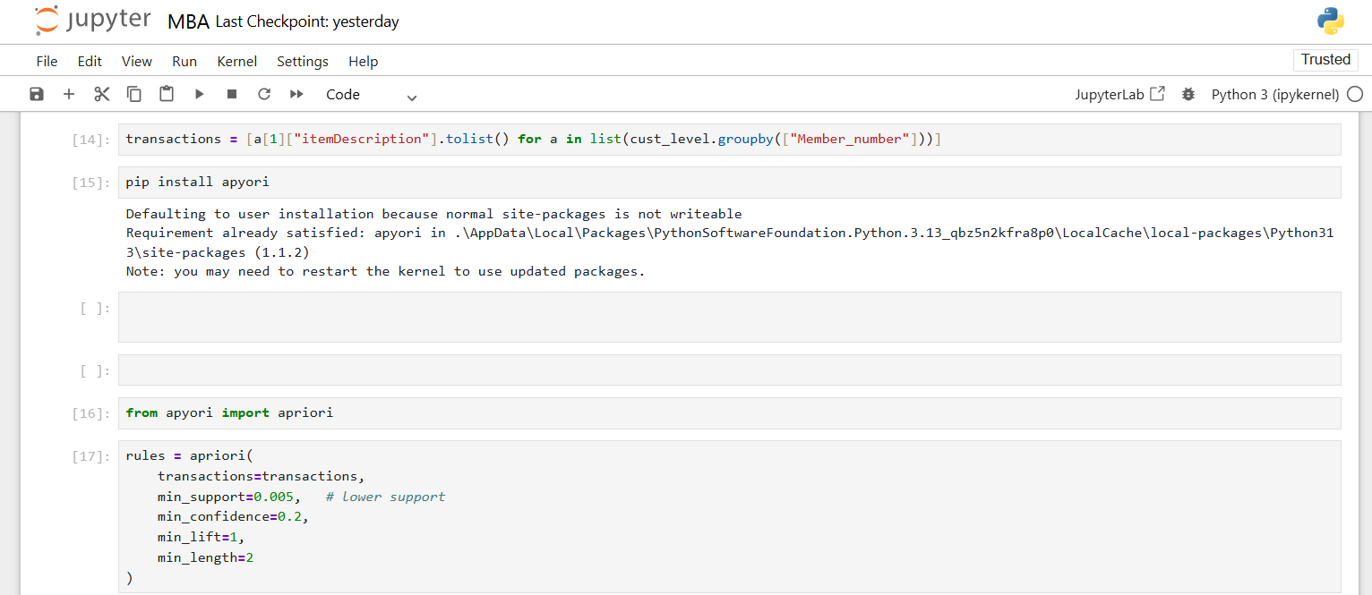

Slide 17
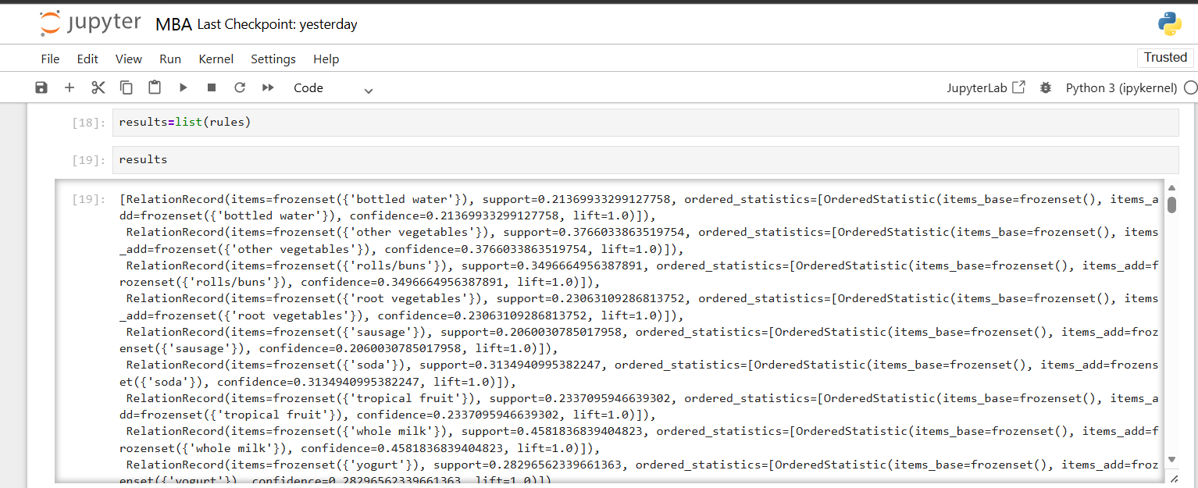

Slide 18
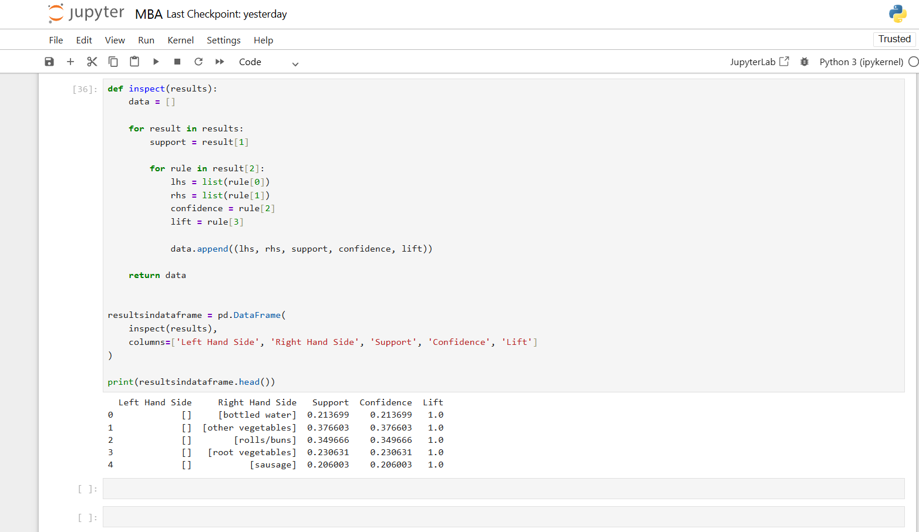

Slide 19
LIMITATION
Results depend on data quality and completeness
Does not consider time-based or seasonal patterns
Computational complexity increases with large datasets
Ignores external factors (price, offers, customer preferences)
May generate irrelevant or weak association rules
Based on historical data, not real-time insights

Slide 20
CONCLUSION
Market Basket Analysis helps identify product relationships and buying patterns
Apriori algorithm is effective in generating association rules
Support, Confidence, and Lift help measure strength of relationships
Interactive dashboard built using Microsoft Power BI improves data understanding
Useful for product recommendation, cross-selling, and decision-making
Can be applied in retail and e-commerce industries.

Slide 21
THANK YOU

